Slide 1

Chapter 15
Transmission
Control
Protocol
(TCP)
TCP/IP Protocol Suite
Copyright © The McGraw-Hill Companies, Inc. Permission required for reproduction or display.

Slide 2

OBJECTIVES:
To introduce TCP as a protocol that provides reliable stream delivery service.
To define TCP features and compare them with UDP features.
To define the format of a TCP segment and its fields.
To show how TCP provides a connection-oriented service, and show the segments exchanged during connection establishment and connection termination phases.
To discuss the state transition diagram for TCP and discuss some scenarios.
To introduce windows in TCP that are used for flow and error control.
TCP/IP Protocol Suite

Slide 3

OBJECTIVES (continued):
To discuss how TCP implements flow control in which the receive window controls the size of the send window.
To discuss error control and FSMs used by TCP during the data transmission phase.
To discuss how TCP controls the congestion in the network using different strategies.
To list and explain the purpose of each timer in TCP.
To discuss options in TCP and show how TCP can provide selective acknowledgment using the SACK option.
To give a layout and a simplified pseudocode for the TCP package.
TCP/IP Protocol Suite

Slide 4
Chapter
Outline
15.1 TCP Services
15.2 TCP Features
15.3 Segment
15.4 A TCP Connection
15.5 State Transition Diagram
15.6 Windows in TCP
15.7 Flow Control
15.8 Error Control
15.9 Congestion Control
15.10 TCP Timers
15.11 Options
15.12 TCP Package
TCP/IP Protocol Suite

Slide 5
TCP Connection
Connection Establishment
Data Transfer
Connection Termination
Connection Reset
TCP/IP Protocol Suite

Slide 6
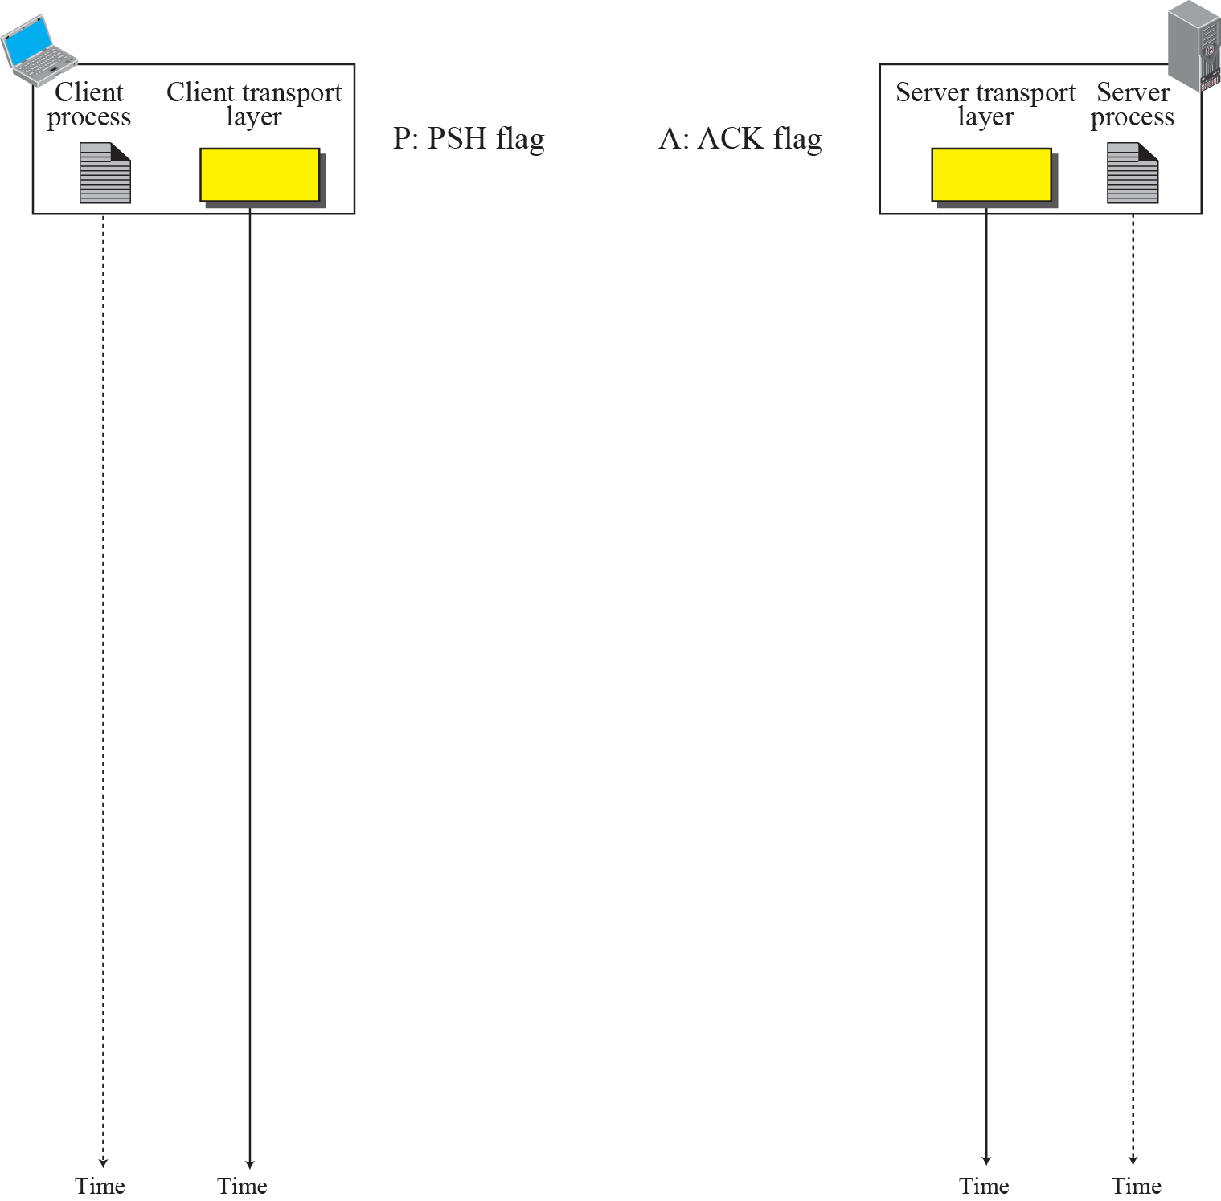
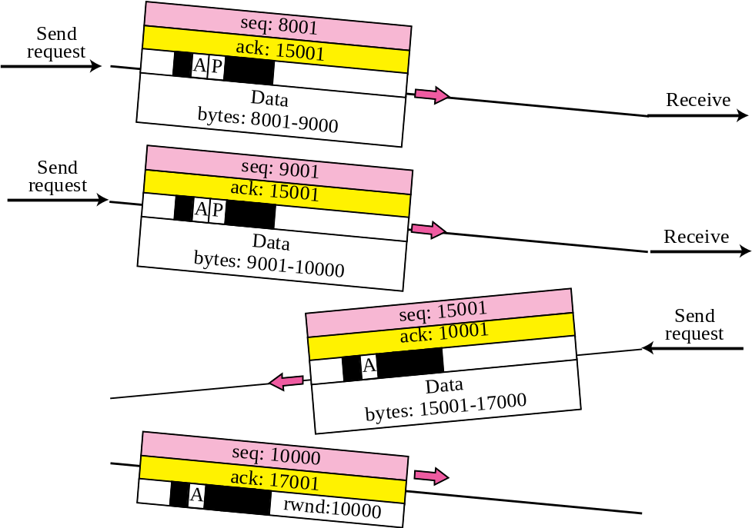

Figure 15.10 Data Transfer
Pushing data
Urgent data
TCP/IP Protocol Suite

Slide 7
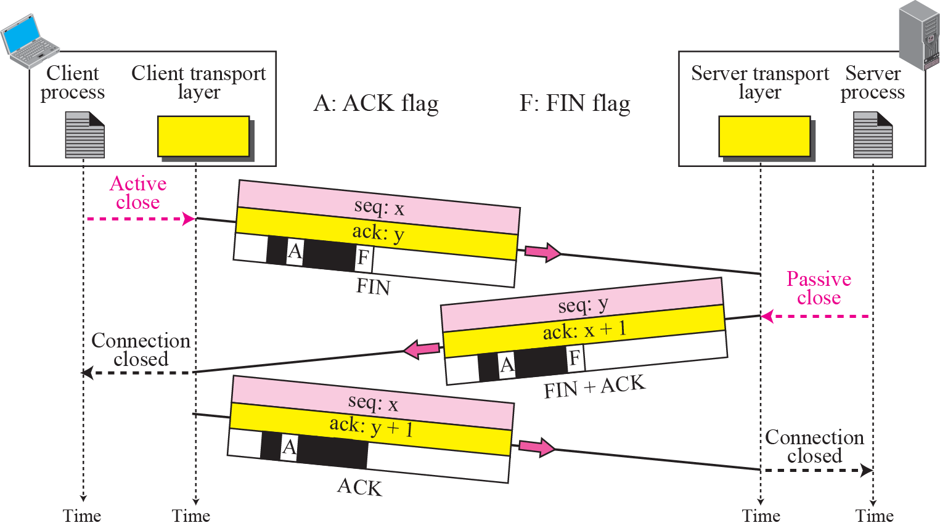
Figure 15.11 Connection termination using three-way handshake
TCP/IP Protocol Suite

Slide 8

Note
The FIN segment consumes one sequence number if it does
not carry data.
TCP/IP Protocol Suite

Slide 9
Note
The FIN + ACK segment consumes one sequence number if it does
not carry data.
TCP/IP Protocol Suite

Slide 10
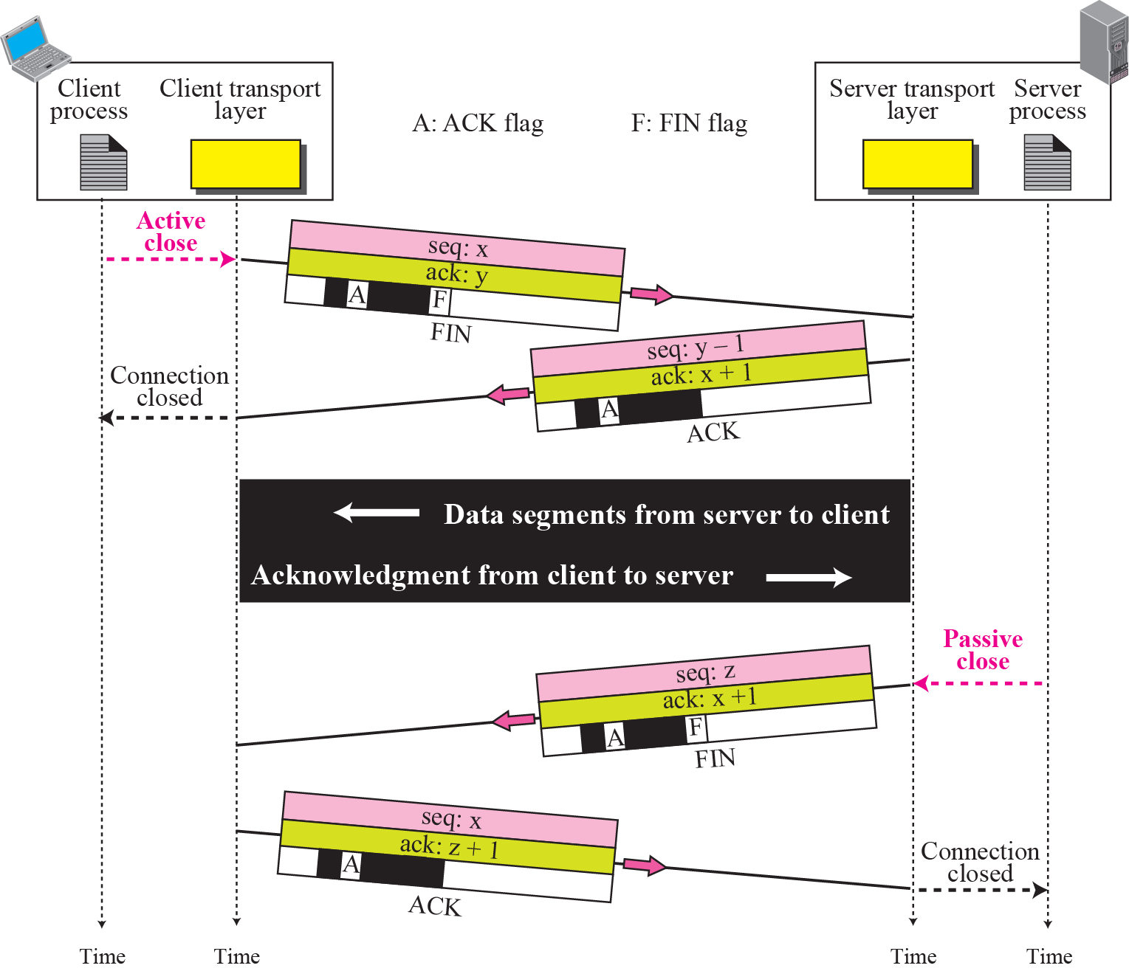
Figure 15.12 Half-Close
TCP/IP Protocol Suite

Slide 11
Connection Reset
Denying a Connection.
Aborting a Connection
Termination an Idle Connection.
TCP/IP Protocol Suite

Slide 12
End of 15.4_TCP Connection
TCP/IP Protocol Suite

